Slide 1
FestMart Sales Analysis
by Olusola Timothy Ogundepo

Slide 2
INTRODUCTION
FestMart is a leading e-commerce retailer that has been at the forefront of the online shopping revolution since its inception in 2008. With a vast product catalog ranging from electronics to apparel, home goods, and more, FestMart has become a trusted destination for millions of customers worldwide.
Committed to providing an exceptional online shopping experience, FestMart continuously invests in cutting-edge technologies and data-driven strategies to enhance its operations, customer service, and product offerings

Slide 3
FestMart Company Sales Insights (2014-2017)
Overall Sales and Profit:
Financial Achievements:
FestMart generated total sales of £2.30 million over the period from 2014 to 2017.
The company achieved a net profit of £286.40 thousand during this time frame.

Slide 4
FestMart Company Sales Insights (2014-2017)
Category Sales Performance:
Leading Categories:
The Technology category consistently dominated sales across most years.
Exception in 2015:
Furniture outperformed Technology, contributing 36.24% of total sales compared to Technology's 34.6%.
Top Sub-Categories:
Standout performers included phones, chairs, storage, tables, and binders, which drove significant sales within their respective categories.

Slide 5
FestMart Company Sales Insights (2014-2017)
Top Performing Regions:
West and East Regions:
The West region led with sales totaling £725.46 thousand.
Close behind, the East region achieved sales of £678.78 thousand.

Slide 6
FestMart Company Sales Insights (2014-2017)
Region Sales and Profit Comparison:
Lowest Sales and Orders:
The South region recorded the lowest sales (£391.72 thousand) and the fewest orders (6,209) compared to the Central region, which had £501.24 thousand in sales and 8,780 orders.
Profit Margin Analysis:
Despite lower sales, the South region outperformed the Central region in terms of profit margin, showing a 17.44% higher margin.
Key Factor: The Central region experienced losses in the Furniture category due to excessive discounting, while the South region maintained profitability across all categories.

Slide 7
FestMart Company Sales Insights (2014-2017)
Correlation Between Discounts and Profit
Profitability Insights:
Sales with lower discounts consistently resulted in higher profits.
In contrast, higher discounts were associated with reduced profitability.

Slide 8
FestMart Company Sales Insights (2014-2017)
Seasonal Sales Trends:
Seasonal Patterns:
Sales followed distinct seasonal patterns, with clear peaks and troughs observed at specific times throughout the year.

Slide 9

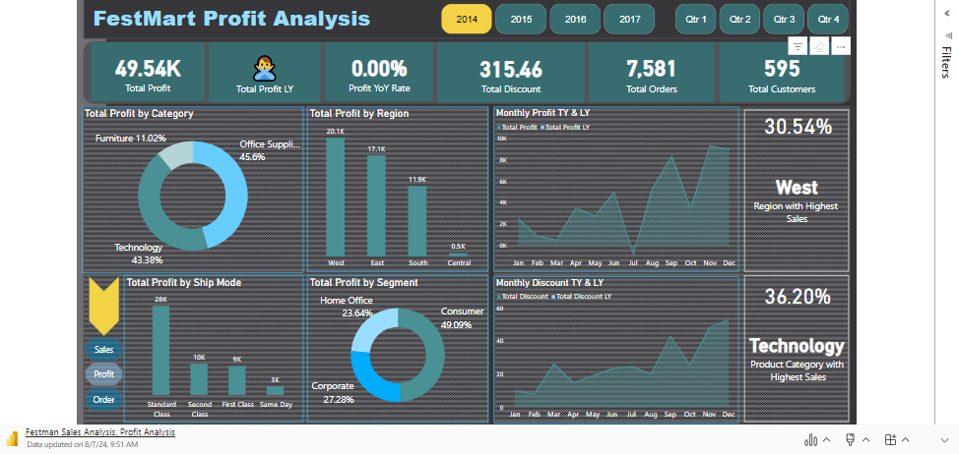
Live FestMart Power BI Dashboards

